Slide 1
AUTOMATIC VEHICLE NUMBER PLATE RECOGNITION SYSTEM
TEAM NAME: ERROR - 404
TEAM MEMBERS:
HARI PRIYA R(1732021)
HARINEE S(1732022)
YOGAPRIYA H(1732060)

Slide 2
AGENDA
INTRODUCTION
WORKING OF THE SYSTEM
METHODOLOGY
STEPS WITH IMAGES
CONCLUSION

Slide 3
INTRODUCTION
This ANPR system is based on image processing technology.
In today’s world with the increasing number of vehicle day by day it’s not possible to manually keep a record of the entire vehicle.
With the development of this system, it becomes easy to keep a record and use it whenever required.
The main objective here is to design an efficient automatic vehicle identification system by using vehicle number plate.
This type of system is widely used in Traffic control areas, tolling, parking area, etc.

Slide 4
WORKING OF THE SYSTEM
Firstly, the application gets the video of the car motion and splits them each as a frame and save them in a specific folder.
Then each frame is passed into the function where the frame’s grayscale ,threshold and the contours of the frame are found.
Then using the contours, the vectors of the possible characters in the scene are detected and given the fixed size of the plate, so that we can find the number of possible plates in the frame.
Then each plate’s grayscale ,threshold and countours are found.

Slide 5
Using the KNN’s trained model we can detect the characters in the plates.
Then each numbers are saved with a condition that it must contain fixed number of characters .
For each frame, we will get a number plate.
These are saved and returns the most repeated number plate.
It checks with database then we can find the person who has owned the car.

Slide 6
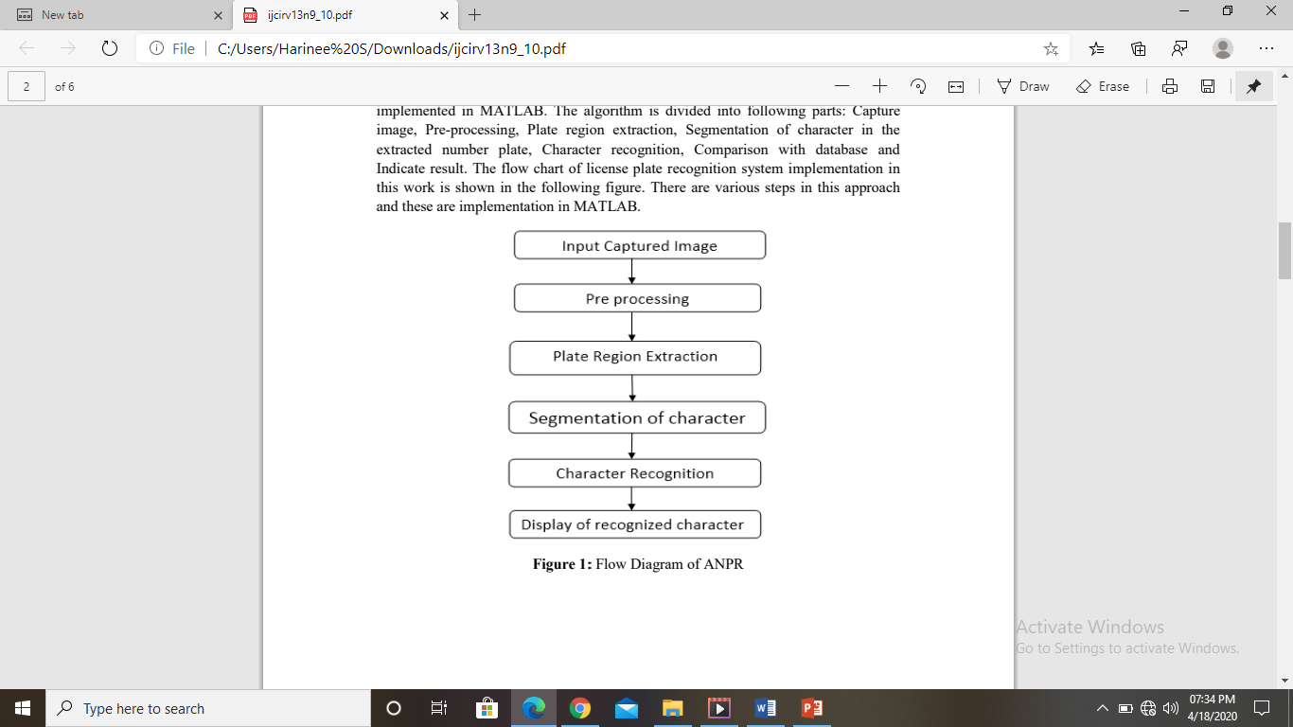
METHODOLOGY

Slide 7
METHODOLOGY
CAPTURING THE IMAGE
PREPROCESSING USING GRAYSCALE, THRESHOLD IMAGES AND CONTOURS
PLATE REGION EXTRACTION
SEGMENTATION OF THE CHARACTER
CHARACTER RECOGNITION
DISPLAY OF RECOGNISED CHARACTER

Slide 8
CAPTURING IMAGE
Initially, the application gets the video of the car motion which contains the number plate.
Splits them each as a frame and save them in a separate folder.

Slide 9
PREPROCESSING USING GRAYSCALE, THRESHOLD IMAGES AND CONTOURS
GRAYSCALE IMAGE : Next, we will preprocess the image using Gray Scale image. Gray Scale is a computer generator image. Here the image will be converted into shades of gray.
THRESHOLD IMAGE : The converted Gray Scale image will be preprocessed into threshold image. It is a form of segmenting images. This threshold image converts gray scale images into binary image.
CONTOURS : The contours are obtained from the threshold image. Contours are defined as the line of joining all the points along the boundary image that are having the same intensity. Here, contours are used to find possible characters in the image.

Slide 10
PLATE REGION EXTRACTION
The most important stage is the extraction of number plate from eroded image significantly.
The extraction can be done by using image segmentation method.

Slide 11
SEGMENTATION OF THE CHARACTER
Segmentation is the process of cropping out the labelled blobs.
These blobs are expected to be the required portion of the license number.

Slide 12
CHARACTER RECOGNITION
The optical character recognition(OCR) is now used to compare the each individual character with the character stored in the database.
Using the KNN’s trained model we can detect the characters in the plates.
The translation of character image into character codes, such as ASCII of the license number.
It will contain various possible plates.

Slide 13
DISPLAY OF RECOGNISED CHARACTER
For each frame we will get a number plate.
These are saved and returns the most repeated number plate.
It checks with the database and then, we can find the person who has owned the car.

Slide 14
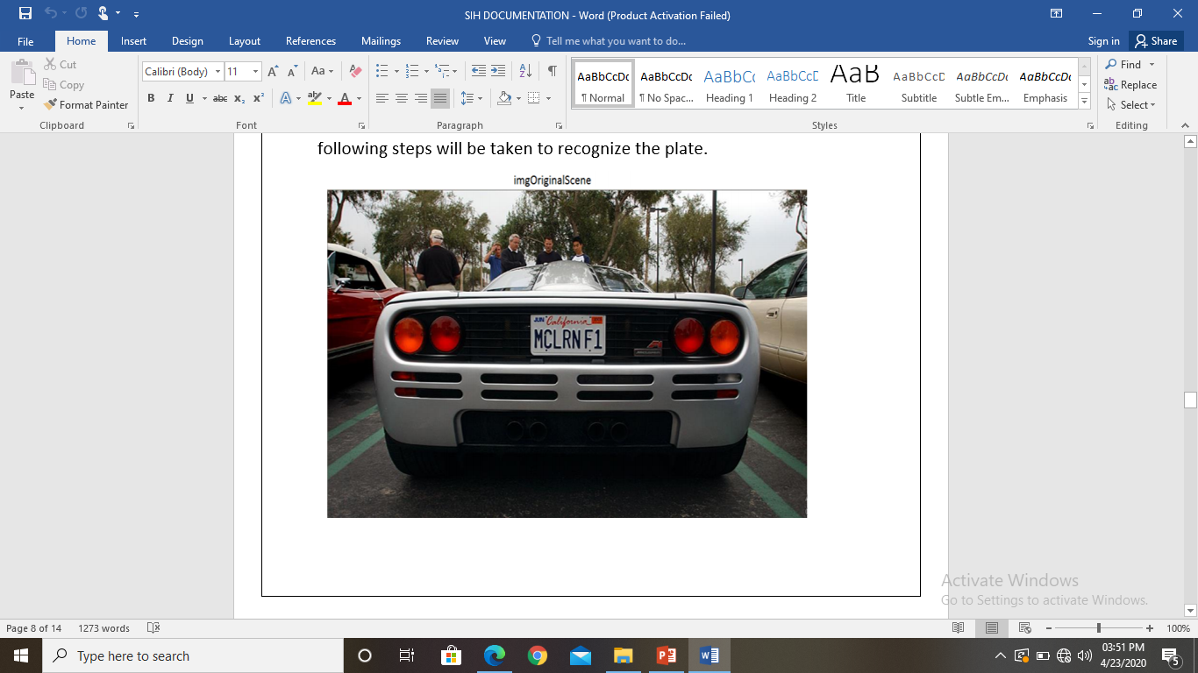
STEPS WITH IMAGES

Slide 15
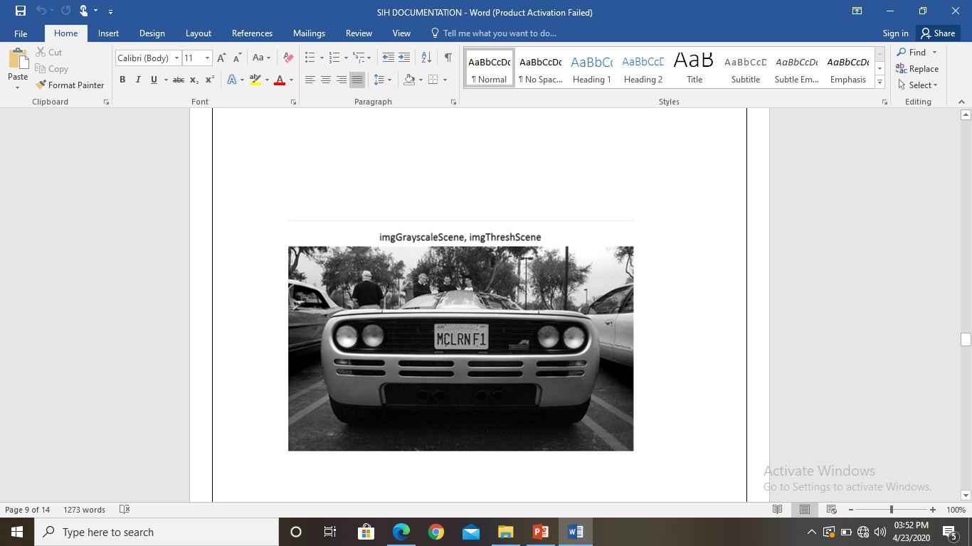
GRAYSCALE IMAGE

Slide 16
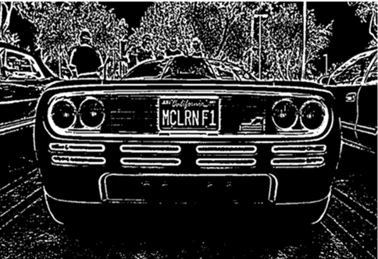
THRESHOLD IMAGE

Slide 17
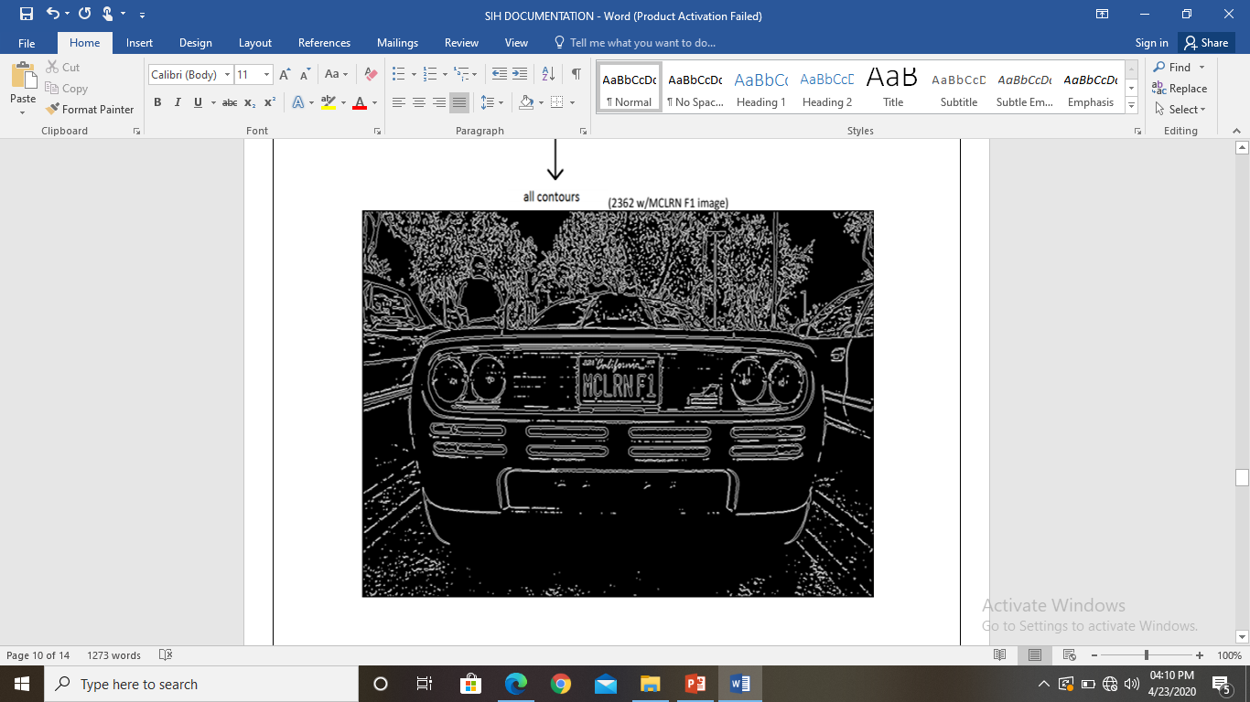
CONTOURS : to find possible characters

Slide 18
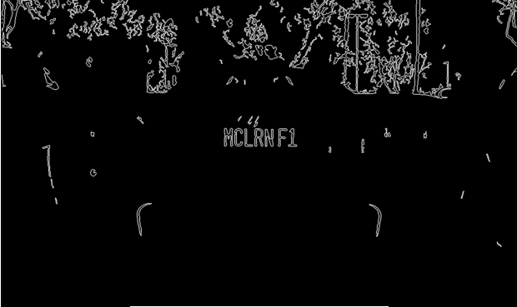
VECTOR OF POSSIBLE CHARACTERS

Slide 19
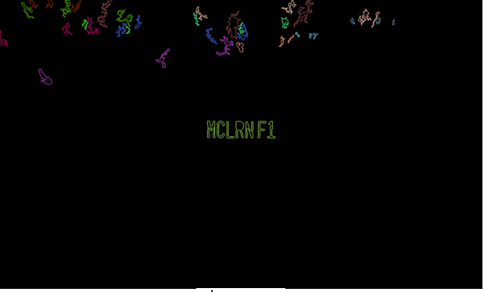
VECTOR OF MATCHING CHARACTERS

Slide 20
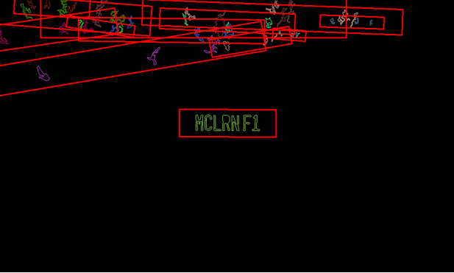
VECTOR OF POSSIBLE PLATES

Slide 21
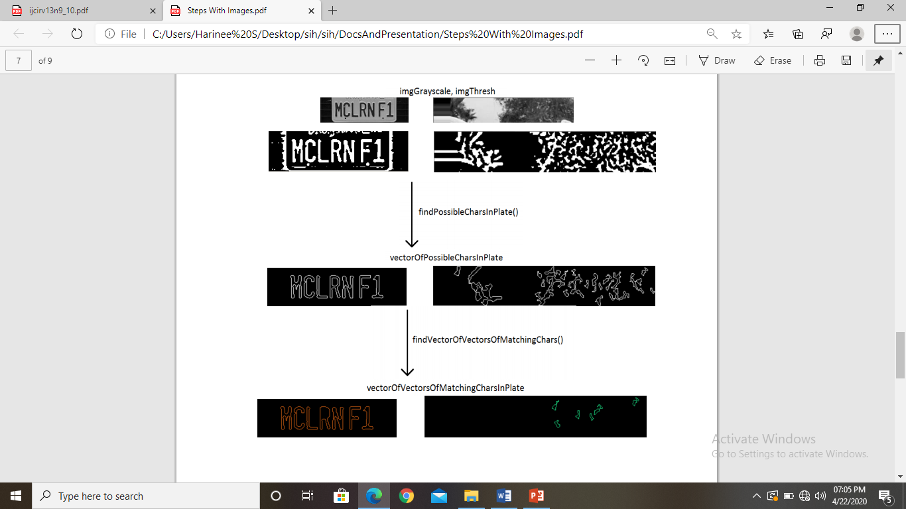
PREPROCESSING USING GRAYSCALE, THRESHOLD, AND CONTOURS

Slide 22
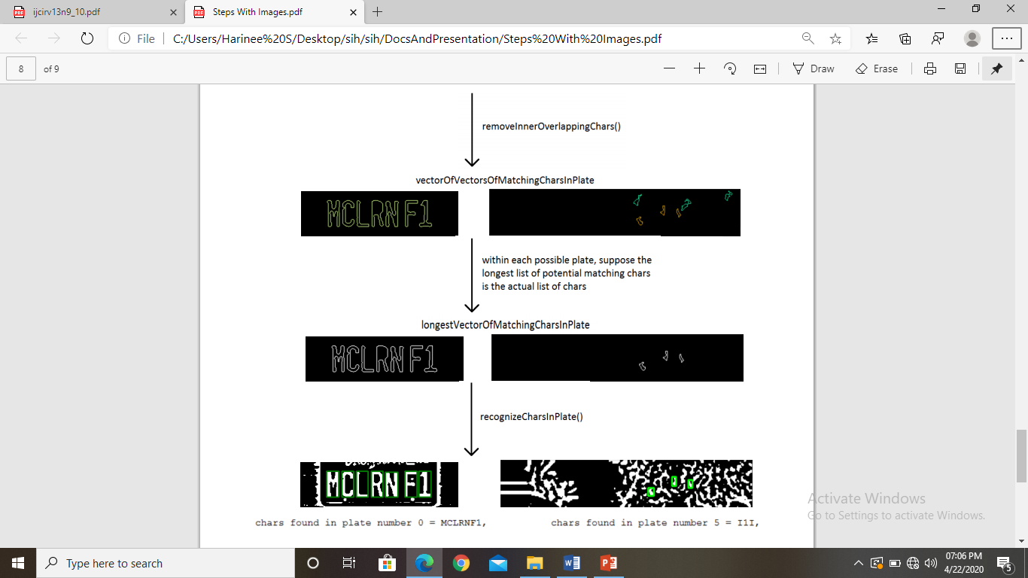
FINDING MATCHING CHARACTERS

Slide 23
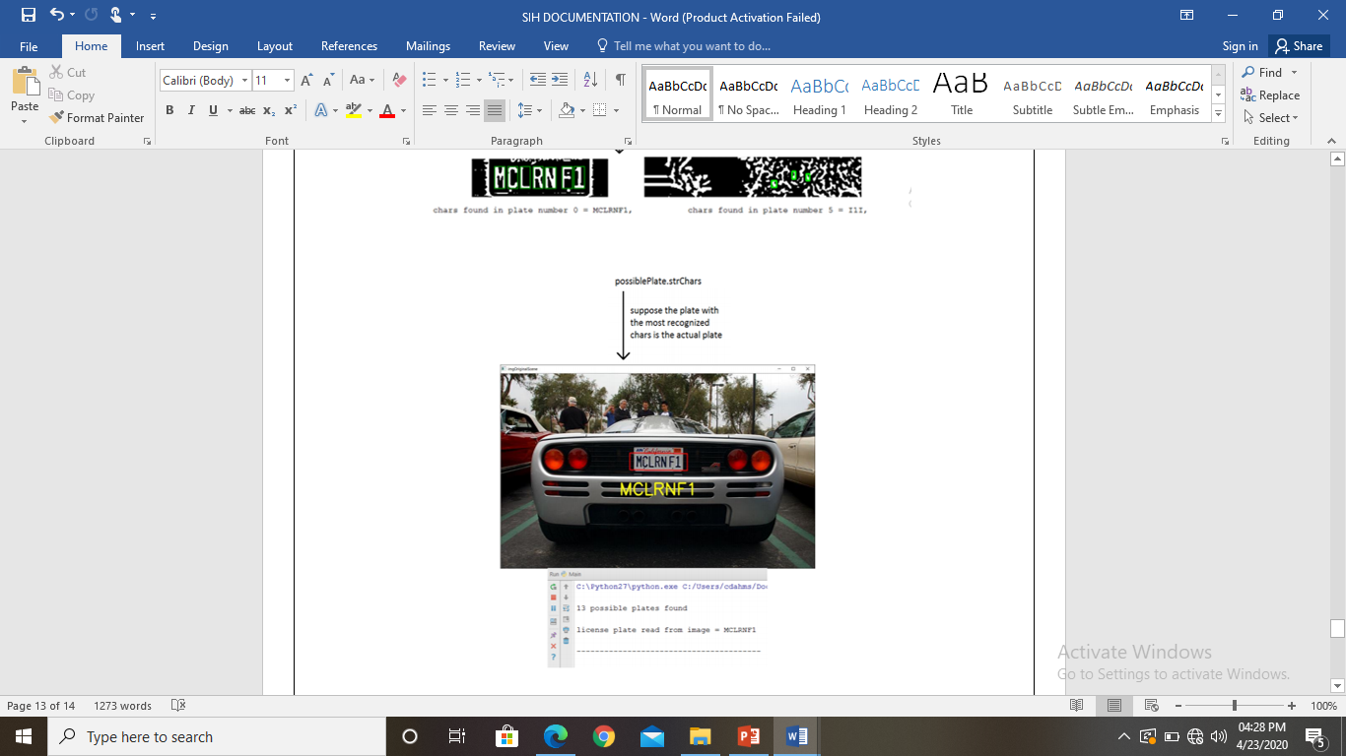
RECOGNIZING THE CHARACTER

Slide 24
CONCLUSION
We have implemented number plate recognition.
Our algorithm successfully detects the number plate region from the image which consists of vehicle number & then character segmentation, recognition.
We have applied our algorithm on many images and found that it successfully recognition.
The project was designed keeping in mind the automation of the number plate detection system for security reason that could replace the current system of manual entry.

